Slide 1
Navigating the 2024 NIH Public Access Policy Office of Research Integrity & Compliance Gabrielle Matinkhah

Slide 2
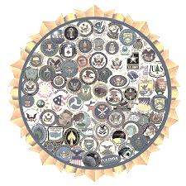
Overview
On July 1, 2025, the updated 2024 NIH Public Access Policy went into effect, requiring all NIH funded investigators to submit their peer-reviewed manuscripts to PubMed Central immediately upon the official date of publication.
This revision eliminated the 12-month embargo period on the 2008 policy and established immediate deposit as a condition of compliance.
Of note:
Other agencies, such as the National Science Foundation are making similar changes to their public access policies. We will be working on resources for these agencies as policies are updated.
Notes:
As a reminder On July 1, 2025…

Slide 3

Learning Objectives
Who: Who does this policy apply to?
What: What does this policy entail?
Where: Where do I publish to ensure compliance with the policy?
When: When does this policy go into effect and apply to my research?
How: How do I ensure and prove compliance?
Why: Why is it important to comply and why were these changes made?
https://publicaccess.research.utah.edu/
Notes:
Learning objectives of todays presentation: focus on the who, what, where, when, how, and why of this policy
Resources and contacts will be provided at the end of the presentation, and the slides will be made available on our new University Public Access website for future reference. A link to the new website is provided here and at the end of the presentation.

Slide 4

Terms & Definitions
PubMed (PM): database of citations and abstracts, excludes full-text articles​
PubMed Central (PMC): electronic archive of freely available full-text journal articles​
NIH Manuscript Submission System (NIHMS): system for submitting manuscripts to PMC​
Recommended to use ”login.gov” login and link to eRA commons​
MyBibliography: reference tool to save citations from PM/PMC or to manually upload citations​
Recommended to use ”login.gov” login and link to eRA commons​
Final Published Article (FPA): journal's authoritative copy, including journal or publisher copyediting and stylistic edits, and formatting changes, even prior to the compilation of a volume or issue or the assignment of associated metadata.​
Author Accepted Manuscript (AAM): author’s final version that has been accepted for journal publication and includes all revisions resulting from the peer review process, including all associated tables, graphics, and supplemental material.​
Official Date of Publication: date on which the Final Published Article is first made available in final, edited form, whether in print or electronic (i.e., online) format. ​
Notes:
I am not going to go over these terms & definitions in detail, but I do want to have them available to ensure an understanding of the differences between PM and PMC, the functions of the NIH manuscript submission system and my bibliography, as well as highlight the policies definitions of a FPA, AAM, and official date of publication. So these have been provided here for quick reference.

Slide 5
Why: Why is it important to comply and why were these changes made?
Non-compliance:​
Delayed awards or renewals
Reduced eligibility for future funding
Institutional audits and/or increased monitoring
Benefits:
Transparency with the taxpayers​ & researchers
Increased and equitable access to research
Compliance with the 2022 Nelson Memo
Notes:
Important to comply because non-compliance may result in:​
Delay of grant awards or renewals​
Reduced eligibility and negative impacts on future funding​
Audits or closer monitoring of our institution​
These updates were made to provide:
Transparency with the taxpayers​ and other researchers
Have increased and equitable access of research to the public
Comply with the 2022 Nelson Memo

Slide 6

Who: Who does this policy apply to?
Researchers funded by NIH in whole or part through:​
grants
contracts
cooperative agreements
intramural research​
NIH employment
Researchers that​ have
Used University NIH funded resources
Such as Clinical & Translational Science Institute (CTSI), Utah Cancer Registry (UCR), and Utah Population Database (UPDB)
If you are unsure, contact their office directly
Notes:
Policy applies to researchers funded by NIH in whole or part through
grants
contracts
cooperative agreements
intramural research​
NIH employment
It also applies to researchers that​ have
Used University NIH funded resources such as
Clinical & Translational Science Institute (CTSI), Utah Cancer Registry (UCR), and Utah Population Database (UPDB)
If you are unsure if the University resources you’ve used are NIH funded, I recommend contacting that office directly

Slide 7
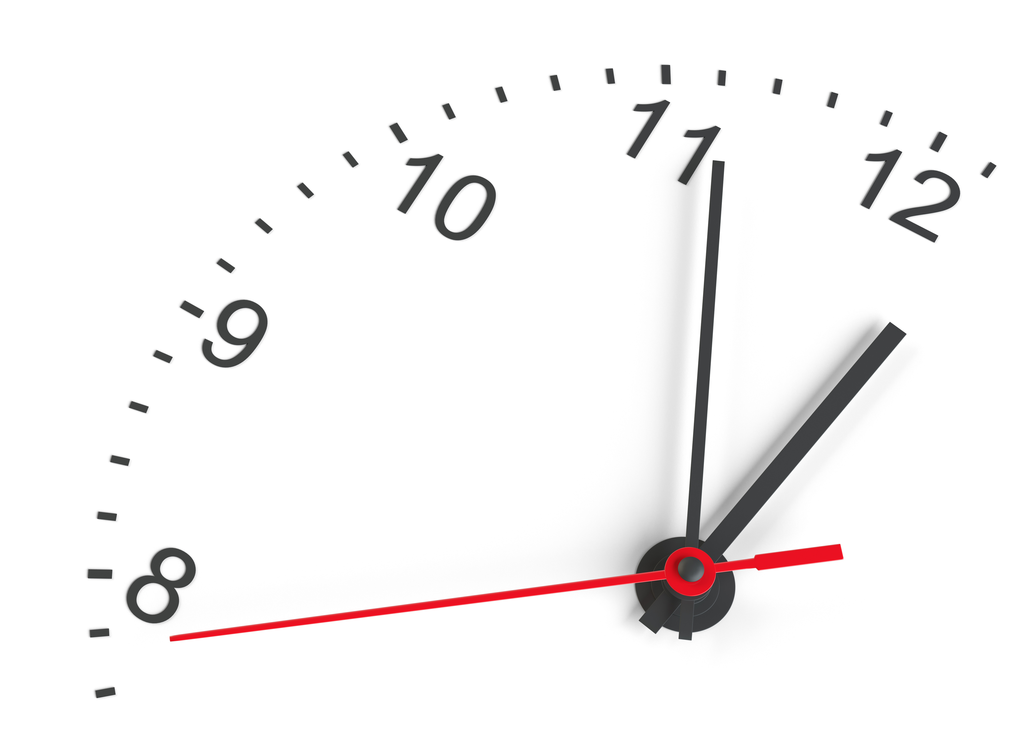
What: What does this policy entail?
Immediate availability of the AAM or FPA to the public on the official date of publication
There is no way to be retroactively compliant. Be proactive and don’t wait until progress reports to check compliance
Acknowledgement of federal funding in the manuscript/article (include all grants applicable to the manuscript)
Rights, acknowledgement, and disclaimer statements
Understanding that in submitting the AAM to NIH you agree to the Government Use License that grants NIH the right to make the AAM publicly available through PMC
Notes:
3 requirements for compliance as stated in the policy
1. Immediate availability of the AAM or FPA to the public on the official date of publication
I do want to emphasize that there is no way to be retroactively compliant with this policy. If the manuscript is not made available by the date of publication, then even if it’s added to PMC later that manuscript will still be considered non-compliant. It’s best to proactive and begin thinking about publication early in the manuscript drafting process.
2. Acknowledgement of federal funding in the manuscript/article. Be sure to acknowledge all applicable grants and I also recommend including rights, acknowledgement, and disclaimer statements.

Slide 8

Rights, Acknowledgement, & Disclaimer Statements
Rights statement:
"This manuscript is the result of funding in whole or in part by the National Institutes of Health (NIH). It is subject to the NIH Public Access Policy. Through acceptance of this federal funding, NIH has been given a right to make this manuscript publicly available in PubMed Central upon the Official Date of Publication, as defined by NIH."
Acknowledgement statement:
"Research reported in this [publication/press release] was supported by [name of the Institute(s), Center, or other NIH offices] of the National Institutes of Health under award number [specific NIH grant number(s) in this format: R01GM987654]." (If you have more than one grant, only cite the grant(s) that supported the research described in the article or presentation.)”
Disclaimer:
“The content is solely the responsibility of the authors and does not necessarily represent the official views of the National Institutes of Health.”
Notes:
These are sample rights, acknowledgement, & disclaimer statements as recommended in the:
NIH supplemental guidance (https://grants.nih.gov/grants/guide/notice-files/NOT-OD-25-049.html Supplemental Guidance),
NIH Grants Policy (https://grants.nih.gov/grants/policy/nihgps/nihgps.pdf),
NIH policy & compliance requirements page (https://grants.nih.gov/policy-and-compliance/policy-topics/federal-funding)
Available here for future reference.

Slide 9
Where: Where do I publish to ensure compliance with the policy?
Ultimately, the article must be deposited into PMC to ensure compliance
Deposited via the NIH Manuscript Submission System (NIHMS)
Deposited by author, author delegated individual, or journal/publisher
PMCID is proof of compliance
NIHMSID is proof of temporary compliance (up to 3 months)
Notes:
Ultimately, the article must be deposited into PMC to ensure compliance. It’s deposited via the NIH manuscript submission system and can be deposited by the author, delegated individual, or the journal/publisher.
PMCID is proof of compliance, but a NIHMSID may be used as proof of temporary compliance for up to 3 months .
I will go into more detail on these ID numbers later in the presentation.

Slide 10

Picking a Publisher
Open access vs public access​
Open access: publishing method that makes article freely available on the publisher's website
Access must be immediate (no embargo) to comply if rights are not retained
Public access: access method in which research is made freely available to the public
NIH ensures this by requiring all articles be deposited into PMC
Hybrid ​
Subscription AND open access option, must choose open access, OR must allow author to retain rights to self deposit
Article processing charge (APC) generally required​​ for open access
UU funded journals​
Agreement with the U library, APC​ covered
Needed to comply with NIHPAP if author is not otherwise permitted retention of rights to self deposit
Notes:
When it comes to picking a publisher there are a few terms I’d like to review.
First is open access vs public access​, open access does NOT equal public access
Open access is a publishing method that makes article freely available on the publisher's website
Generally needed to comply with the policy unless the author is permitted rights to self deposit
Access must be immediate to comply if rights are not otherwise retained.
Public access is an access method in which research is made freely available to the public. NIH ensures this for their funded research by requiring all articles to be deposited and made freely available on PMC
A Hybrid ​option offers both a subscription and open access option.
Usually, must choose the open access​ option to comply or you must be allowed to retain rights to self deposit
Article processing charge is typically required for the open access option
The university of Utah has funded journals in which they have an agreement with the Marriott Library where the APC is covered if you choose to publish with that specific journal. A link to a list of publishers that have agreements with the library and other publishing resources will be made available at the end of this presentation as well as on our new University Public Access website. But, please note these agreements are always subject to change.

Slide 11
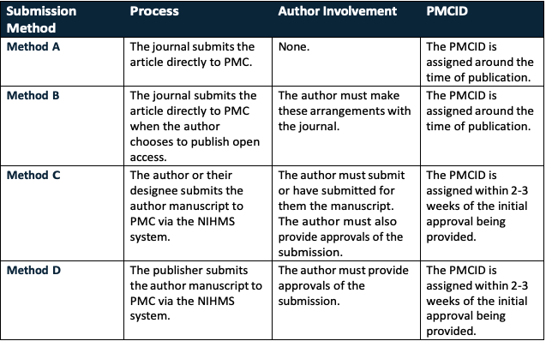
Methods to Achieve Compliance
Notes:
This image from the Eccles Library highlights the details of different submission methods and how they work. We will not go into to detail on this today, but it is available here for future reference and additional information can be found on our new University Public Access website in which the URL will be provided at the end of this presentation.

Slide 12
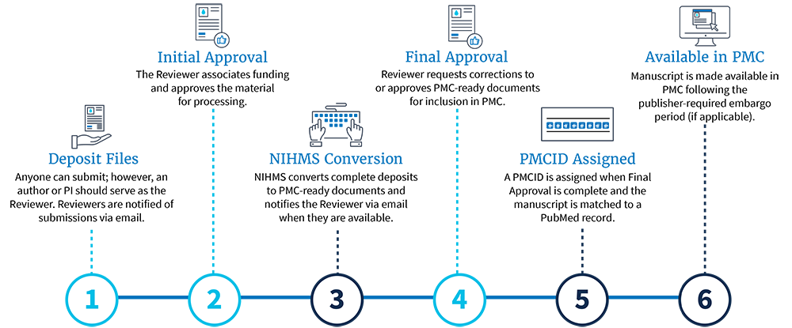
NIHMS Submission Process
Notes:
And this image highlights the 6 step NIHMS submission process, I will not go into detail but wanted to ensure it was available for quick reference as well. additional information can be found on our new University Public Access website.

Slide 13
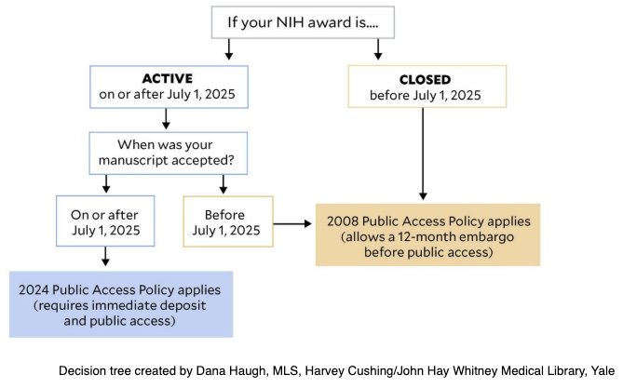
When: When does this policy go into effect and apply to my research?
Any peer reviewed manuscripts accepted on/after July 1, 2025​
- award open on/after July 1, 2025
If these terms don't apply adhere to the 2008 policy (12-month embargo)
Notes:
Policy applies to any peer reviewed manuscripts accepted on/after July 1, 2025​ with an award considered open on/after July 1, 2025.
If these terms don't apply to you then you can adhere to the 2008 policy which allots a 12-month embargo for public access, however now that it has been several months since the policy went into effect you should plan on most likely needing to comply with the 2024 policy.

Slide 14
How: How do I ensure and prove compliance?
Proving compliance
PMCID with an “available by” date around the official date of publication is proof of compliance, add to citation once received
May use NIHMSID in lieu of PMCID for up to 3 months
PMID is not the same as PMCID
Compliant citations
Use MyBibliography to check and update citation compliance
Reference of all applicable NIH awards
Reference awards in citation
Ensure any awards from NIH funded departmental resources are referenced
I.E. if you used CTSI (NIH funded) resources, then cite the specific CTSI award
Notes:
When it comes to proving compliance
Your PMCID is proof of compliance, ensure this is added to your citation once received. The PMCID "available by" date should be around the same time as the "publishing date", having a PMCID on its own does not necessarily mean you are compliant.
When you start the submission process, you'll receive a NIHMSID which can be use in lieu of PMCID for up to 3 months while waiting for the PMCID to be received
I do want to emphasize that a PMID (PubMed ID) is not the same as a PMCID (PubMed Central ID) as they are two different systems.
Next ensure citations are compliant by using My Bibliography to check and update citation compliance
And then be sure to reference all applicable NIH awards in your citation
And if you’ve used any NIH funded departmental resources such as CTSI then be sure to associate that specific CTSI award in your citation

Slide 15
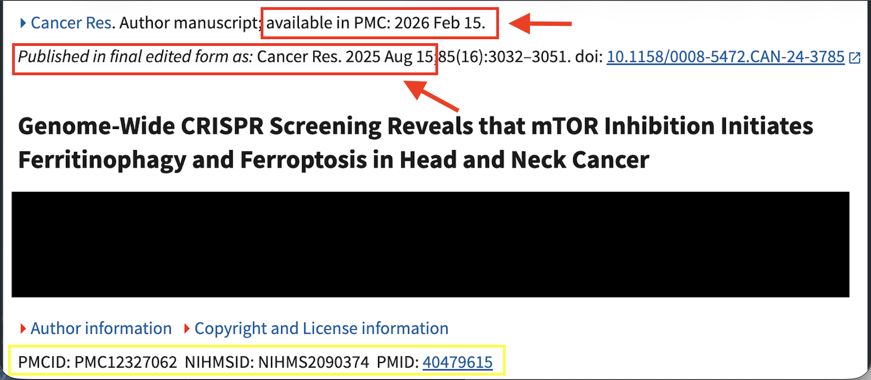

Example of a non-compliant article
PMCID is not automatic proof of compliance, it needs to be available in PMC by the official date of publication
Notes:
Here is an example of a non-compliant article. As you can see circled in red the available in PMC date is months after the published in final edited form date.
Even though the article does have a PMCID showing that it has been deposited into pub med central it is still not considered compliant because it was not available by the official date of publication.

Slide 16
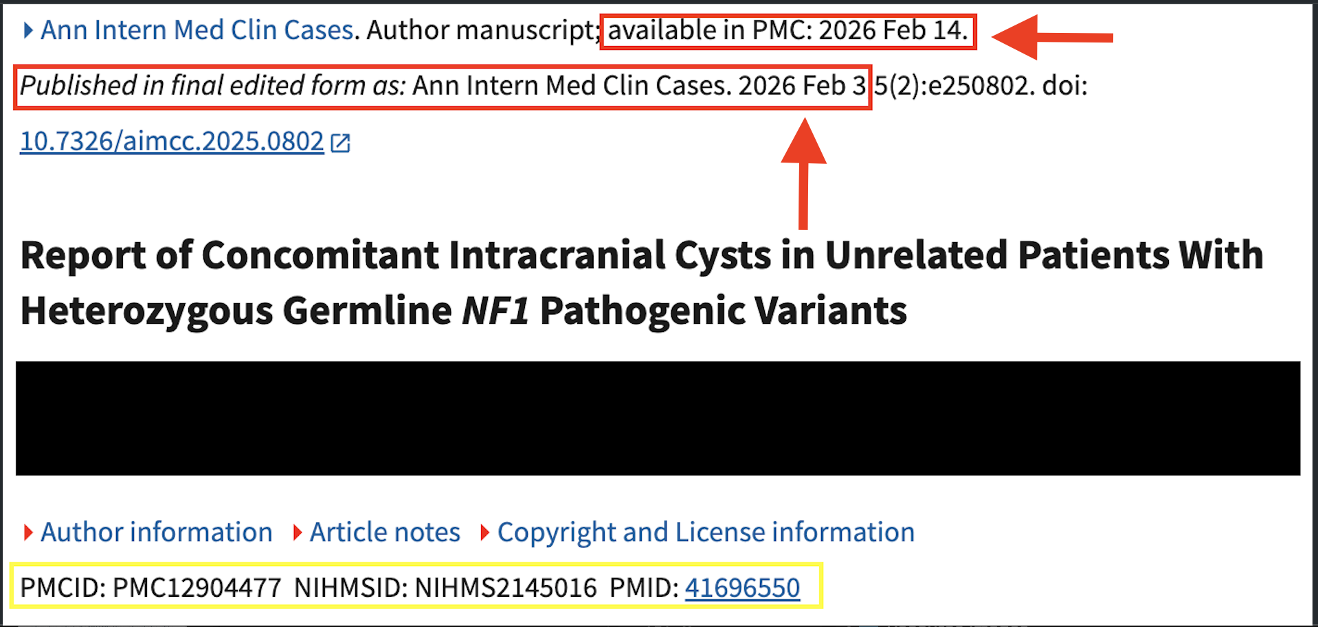
Example of compliant article
a PMID is NOT the same as a PMCID
Notes:
Here is an example of a compliant article. As you can see circled in red the available in PMC date is around the same times as the published in final edited form date making it compliant.
Again as a reminder, a PMID is not the same as a PMCID which is why both are present on this citation.

Slide 17

Things are changing quickly!
Please acknowledge publishing agreements and policy clarifications are being updated regularly. For most current information, refer to the NIH FAQs. University websites will be updated as quickly as possible, brief delays may occur.
Notes:
I want to emphasize that things are changing quickly! For the most current information refer to the NIH FAQs page. University websites will be updated as quickly as possible but brief delays may occur.

Slide 18
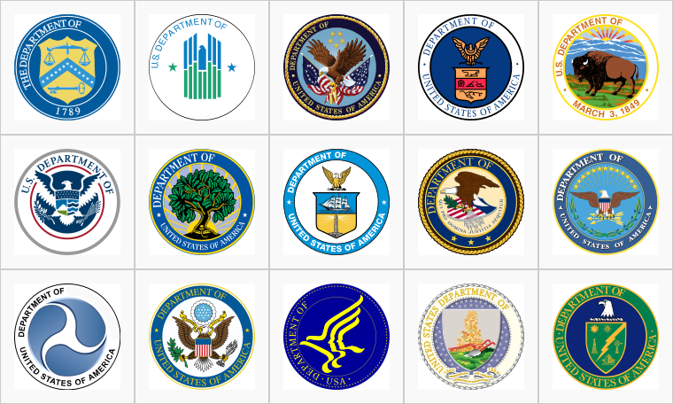
Other Federal Agencies
Keep in mind other federal agencies may have similar requirements or may update their policies
National Science Foundation
January 22, 2026 Supplemental Policy Notice removed 12-month embargo, AAMs publicly available “at or before the time of publication”

Slide 19
Resources/Links
Notes:
These last few slides provide resources to assist with navigating the policy, publishing, contacts, etc.

Slide 20
Policy resources
2024 NIH Public Access Policy
Supplemental Guidance
NIH Grants Policy Statement
NIH Acknowledging Funding Guidance
NIH FAQs
“Sharing” section has most information of policy related items
NIH public access help desk contact: publicaccess@nih.gov
Notes:
So you’ll find direct links to all these resources on the slides.
2024 NIH Public Access Policy
https://grants.nih.gov/grants/guide/notice-files/NOT-OD-25-047.html
Supplemental Guidance
https://grants.nih.gov/grants/guide/notice-files/NOT-OD-25-049.html
NIH Grants Policy Statement
https://grants.nih.gov/grants/policy/nihgps/nihgps.pdf
NIH FAQs
https://grants.nih.gov/faqs#/
“Sharing” section has most information of policy related items

Slide 21
Publisher resources
UU-funded open access publishing (search journals here)
List of publishers currently with University funding agreements
List of compliant journals per NIH
Confirm release delay of “0 months (immediate release)”, an agreement to deposit “all articles”​ or “NIH-funded articles”, and an active agreement status
List of selective deposit journals per NIH
author can arrange with journal for the deposit of a specific article OR,
Retain rights to self-deposit
Library contact: openaccess@lists.utah.edu
Notes:
UU-funded open access publishing
https://campusguides.lib.utah.edu/researchers/uu-oa-publish)
List of publishers that the University has agreements with
https://campusguides.lib.utah.edu/agreements
List of compliant journals with 0 embargo​ per NIH
https://pmc.ncbi.nlm.nih.gov/journals
Confirm release delay of “0 months (immediate release)” and an agreement to deposit “all articles”​
List of selective deposit journals (author can arrange with journal for the deposit of a specific article) per NIH
https://pmc.ncbi.nlm.nih.gov/about/selectivedeposit
If using a publisher there should be no cost to comply with the NIH policy, meaning if the publisher is trying to charge you solely to submit to PMC this is against NIH policy.​
This is different than an article publishing charge (APC) which is determined by the publisher to publish in their journal​
Library contact for specific publisher/journal questions: ehsl-reference@lists.utah.edu
recommend verifying with them before proceeding with any contracts/agreements

Slide 22
Citation & Submission Resources
My Bibliography Help Manual
NIHMS Submission
Overview
Tutorials
PubMed Central Overview
CTSI Overview & Award List
Notes:
My Bibliography
https://www.ncbi.nlm.nih.gov/books/NBK53595/
NIHMS Submission
Overview: https://www.nihms.nih.gov/about/overview/
Tutorials: https://www.nihms.nih.gov/help/tutorials/
PubMed Central
https://pmc.ncbi.nlm.nih.gov/about/intro/
CTSI
https://ctsi.utah.edu/funding-opps-resources/grant-support-services/cite-and-submit

Slide 23
Websites
PubMed Central Home
MyBibliography Home
eRA Commons Home
NIHMS Home
University of Utah Eccles Library Resource
University of Utah Public Access Website
https://publicaccess.research.utah.edu/
Notes:
As previously mentioned we have launched the new University of Utah Public Access website, designed to provide resources to assist with navigating public access policies. So please see that URL here.
PubMed Central Home
https://pmc.ncbi.nlm.nih.gov/
MyBibliography Home
https://www.ncbi.nlm.nih.gov/myncbi/collections/mybibliography/
eRA Commons Home
https://public.era.nih.gov/commonsplus/public/login.era?TARGET=https%3A%2F%2Fpublic.era.nih.gov%3A443%2Fcommonsplus%2F
NIHMS Home
https://www.nihms.nih.gov/login/?next=/submission/
University of Utah NIH Public Access Policy Overview Home

Slide 24
Contacts
Compliance Specialist: publicaccess@utah.edu
Library: openaccess@lists.utah.edu
OSP: ospawards@osp.utah.edu
Grants & Contracts: gcahelp@utah.edu
NIH Public Access Help Desk: publicaccess@nih.gov
Notes:
Contact information for various groups across the university.

Slide 25

Thank you! See website: publicaccess.research.utah.edu Email questions: publicaccess@utah.edu
Notes:
Thank you for attending this presentation.
Please see our new Public Access website for additional details and please feel free to email with any questions or if you would like to schedule a meeting with your department or study team to discuss the policy further.
These slides will also be posted on our public access website for future reference.

